Slide 1

Final EXAM 2020
Aileen Benz Sabellon

Slide 2
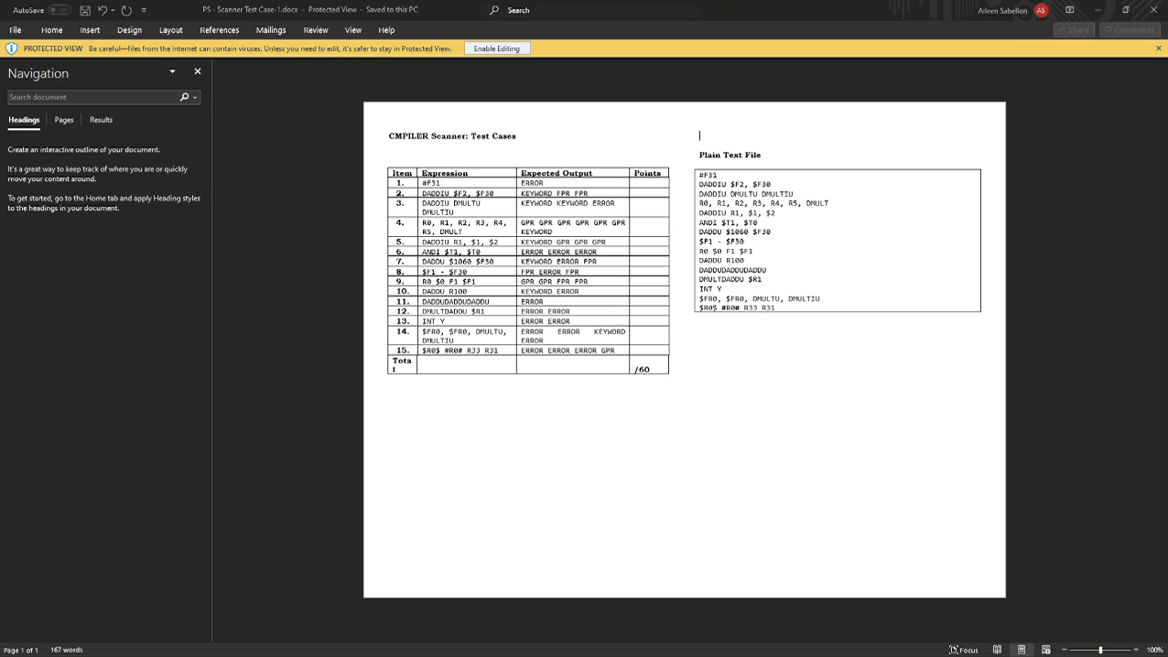
HANDS ON IMPLEMENTATION

Slide 3
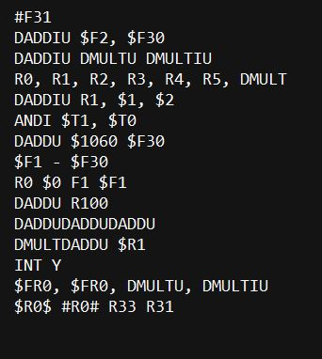
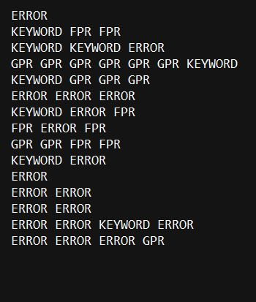
INPUT OUTPUT

Slide 4
Lexical Analyzer

Slide 5
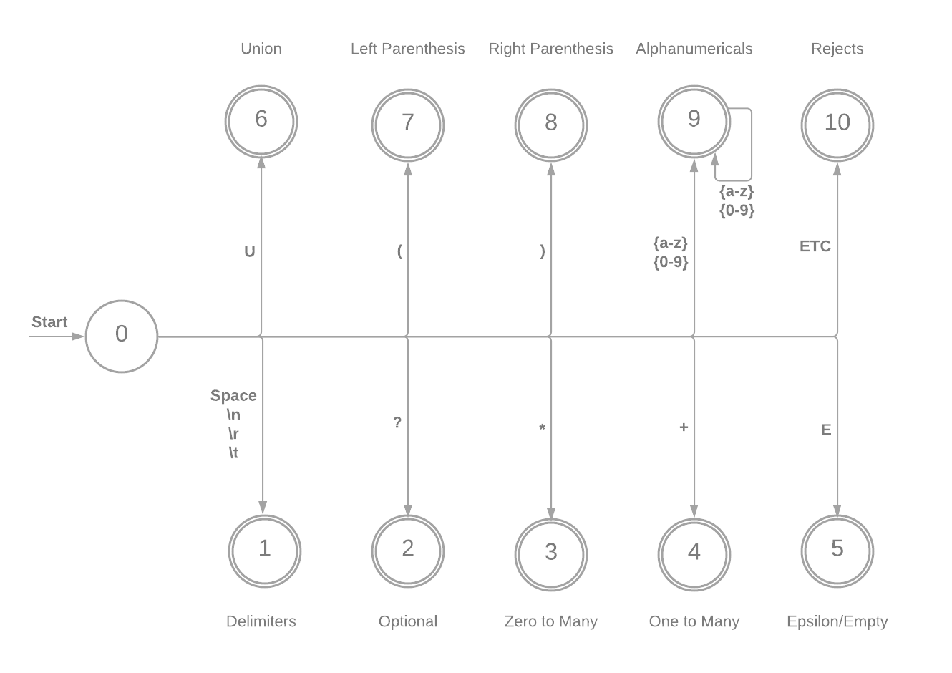
FSM (FSM DIAGRAM)
Final States Accepts:
T = {(a-z), (0-9), *, +, ?, E, U, (,), Errors, Whitespaces}
NOTE:
ETC = Exhausts all other inputs.
Delimiters are accepted but ignored.
Delimiters are also called as “Whitespaces”

Slide 6
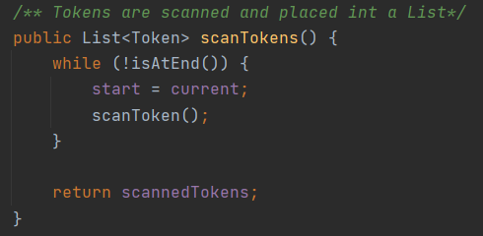
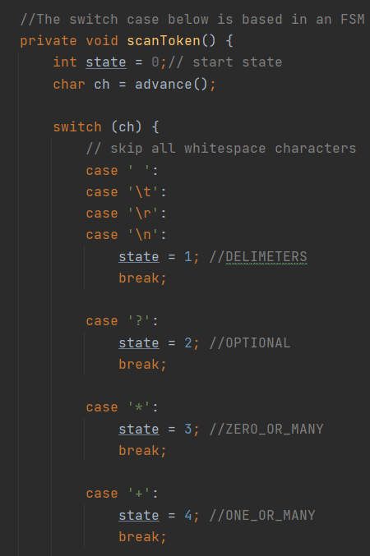
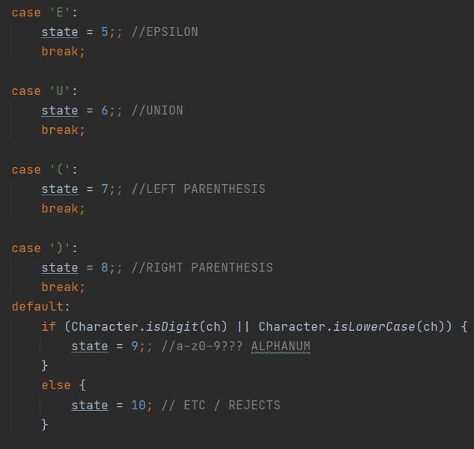
TOKEN CREATION
Token is created using Maximal Munch Algorithm.
All characters are scanned from the file.
Scanned Tokens are placed in a Token List
Then Maximal Munch Algorithm is used to match the input to their designated states.
This will repeat until all characters are exhausted.

Slide 7
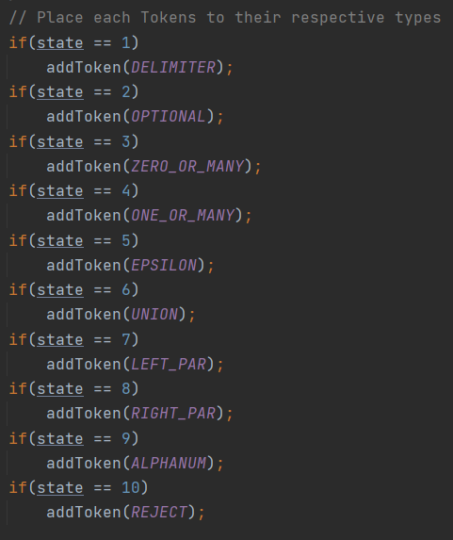
TOKEN CREATION
Once the states of each tokens have been determined,
Place the states to the respective token types. -(OPTIONAL, ZERO_OR_MANY, ZERO_OR_MANY, EPSILON, UNION, LEFT_PAR, RIGHT_PAR, ALPHANUM, REJECT)

Slide 8
PARSER

Slide 9
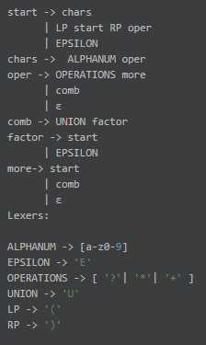
LL(1) GRAMMAR

Slide 10
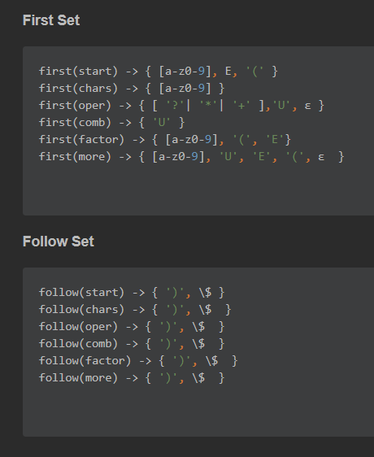
First and Follow Sets

Slide 11
Lookahead Table
 | [a-z0-9] | ['?', '*', '+'] | E | U | ( | ) | ε | $
start | start -> chars |  | start -> ε |  | start -> LP start RP |  | start -> ε
chars | chars -> ALPHANUM oper
oper |  | oper -> OPERATIONS |  | oper -> UNION |  |  | oper -> ε
comb |  |  |  | comb -> UNION
factor | factor -> chars |  | factor -> EPSILON |  | factor-> LP start RP
more | more -> chars |  | more -> EPSILON | more -> comb | more-> LP start RP |  | more -> ε

Slide 12
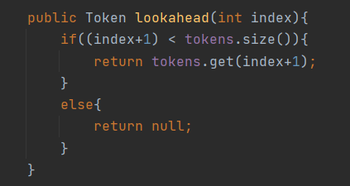
LL(1) Grammar Implementation
“lookahead” is used to peak at the non-terminals and check if the token satisfy the grammar rule.

Slide 13
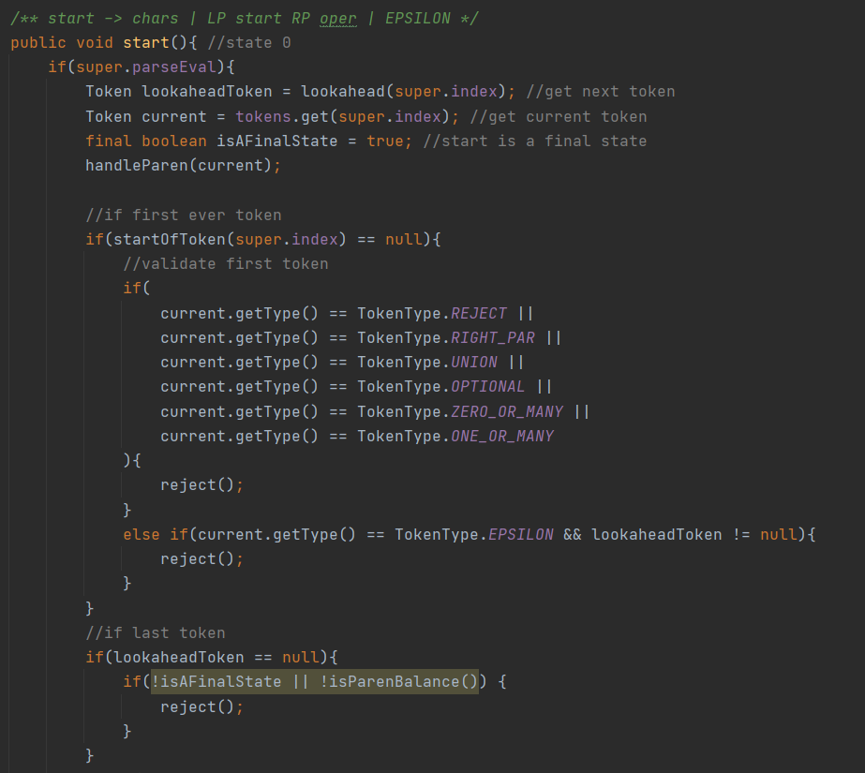
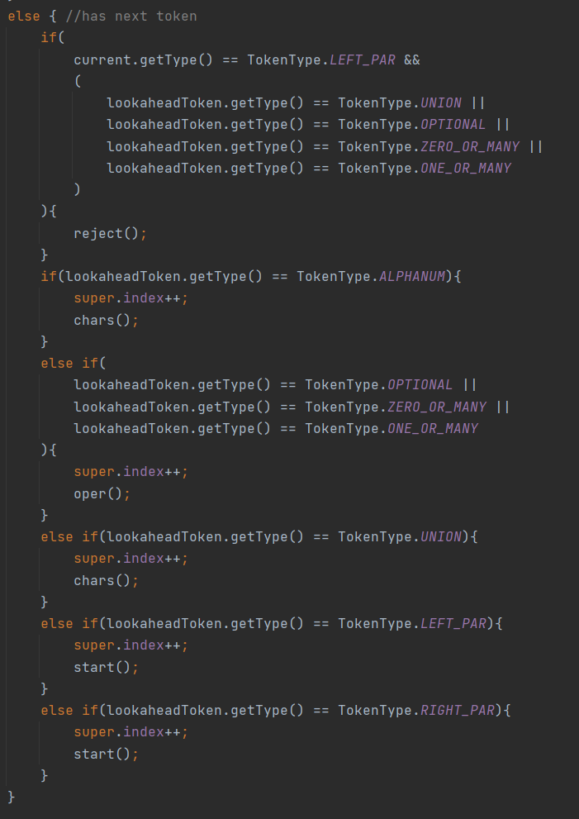
LL(1) Grammar Implementation

Slide 14
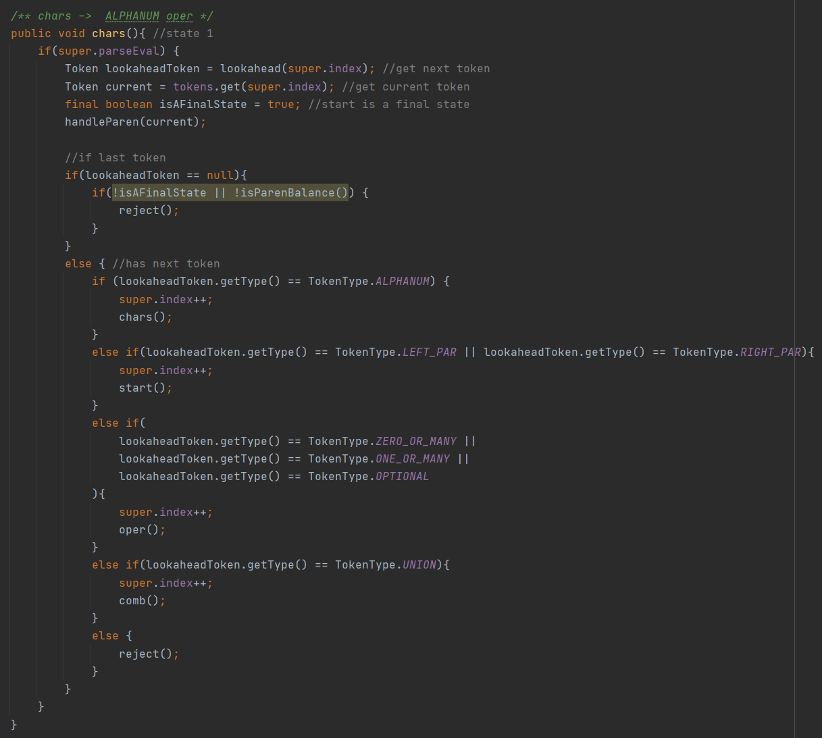
LL(1) Grammar Implementation

Slide 15
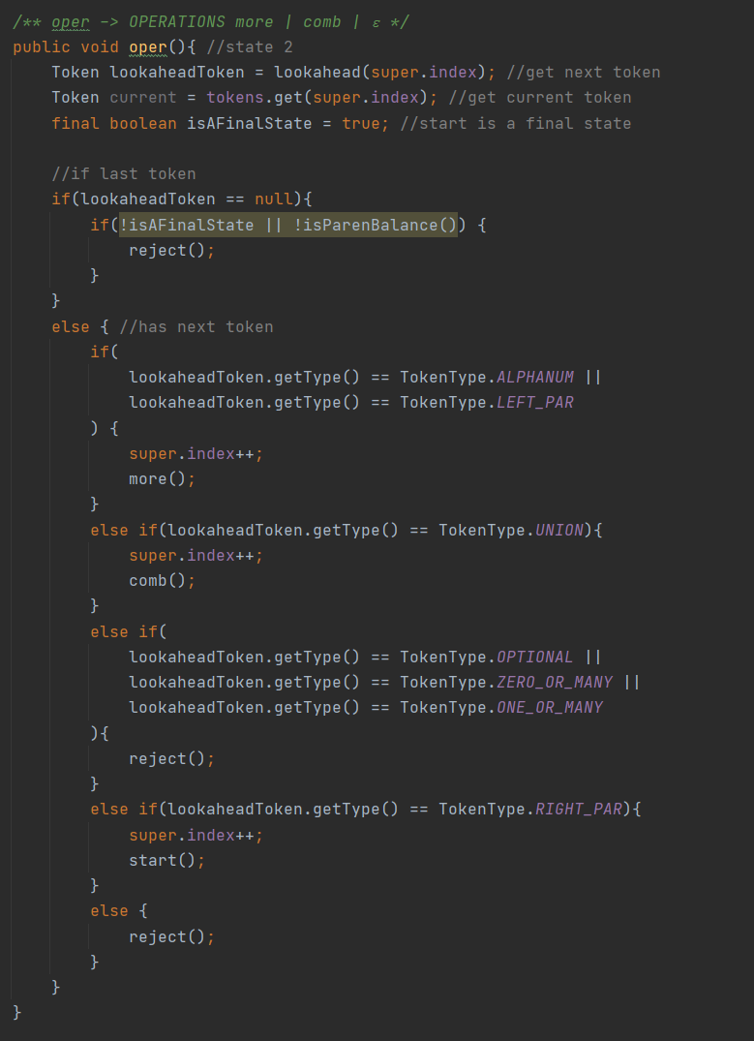
LL(1) Grammar Implementation

Slide 16
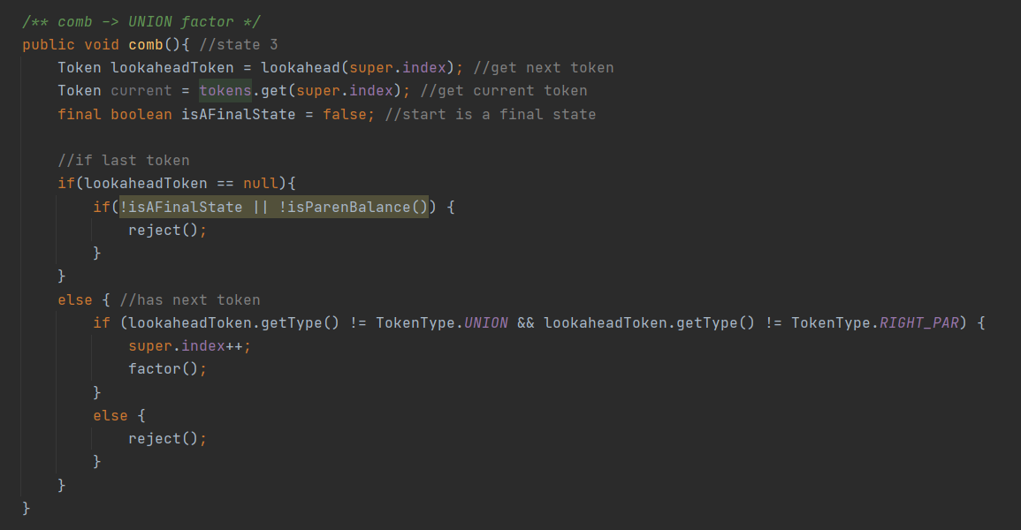
LL(1) Grammar Implementation

Slide 17
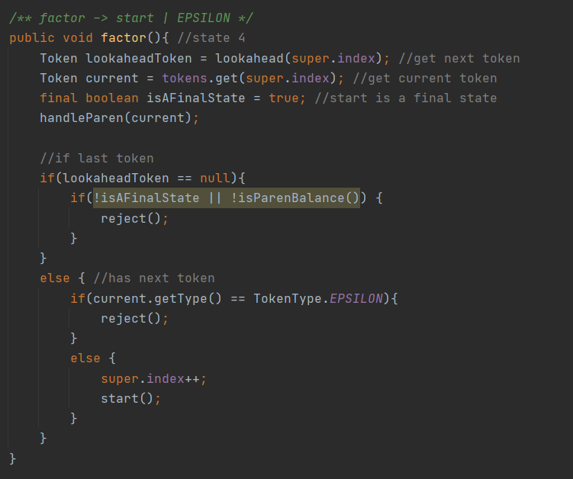
LL(1) Grammar Implementation

Slide 18
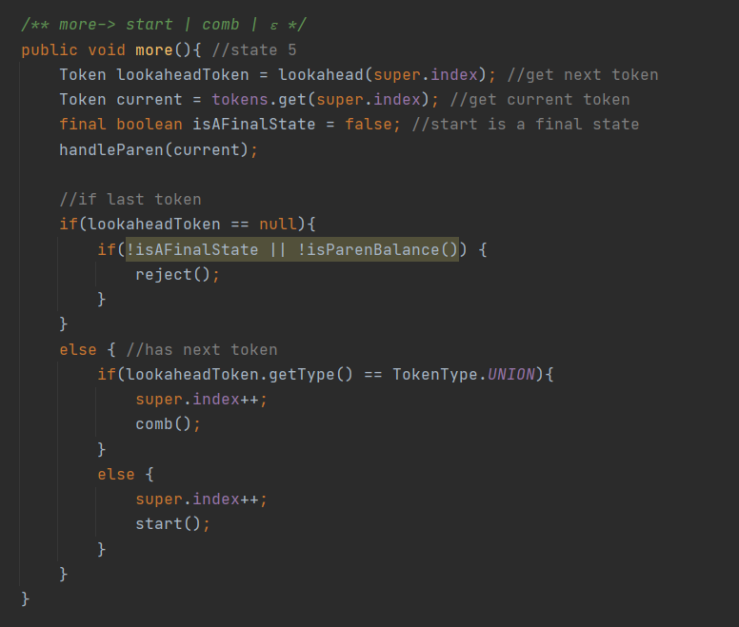
LL(1) Grammar Implementation

Slide 19
RUNNING THE GUI

Slide 20

NOTES:
root
etc
Docs
imgs
DIRECTORY
STRUCTURE:
txtFiles
src
← Project Folder
core
exception
lexer
IDE USED: Intellij
LIBRARY USED: Latest java.
parser
io
ui
fields
util

Slide 21
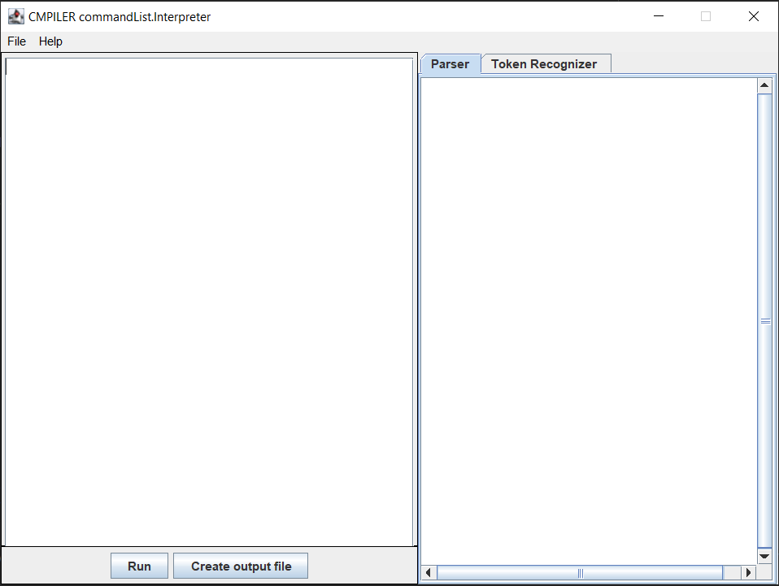
Running the GUI
1. Compile and Run the MainWithGUI.java in the src folder.

Slide 22
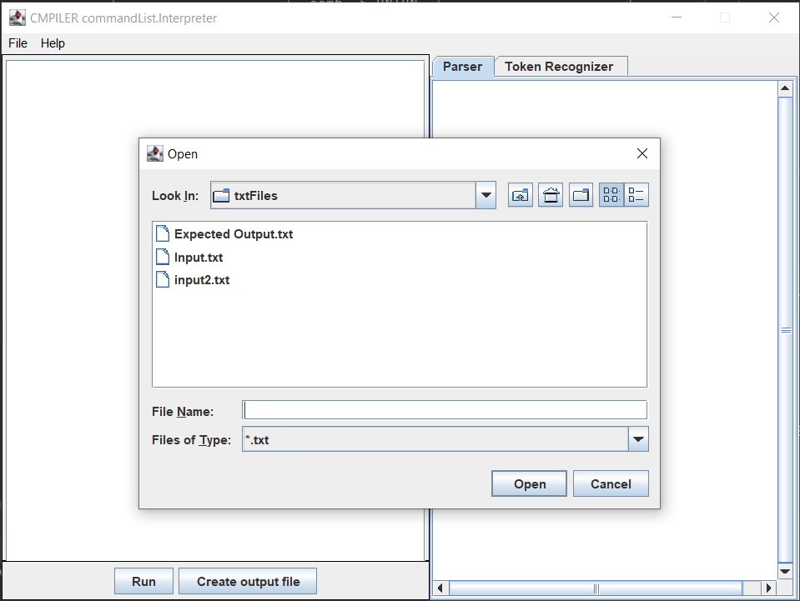
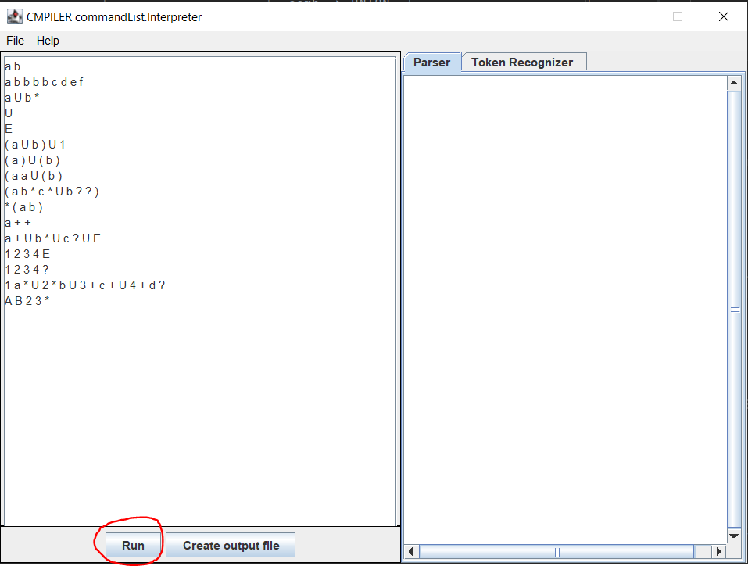
Running the GUI
2. Getting Test Cases Input:
The left side of the Interface is available to write the test cases.
Test cases can also be obtained by opening the file in the File Menu Bar.
The Directory is automatically set to the txtFiles Folder.

Slide 23
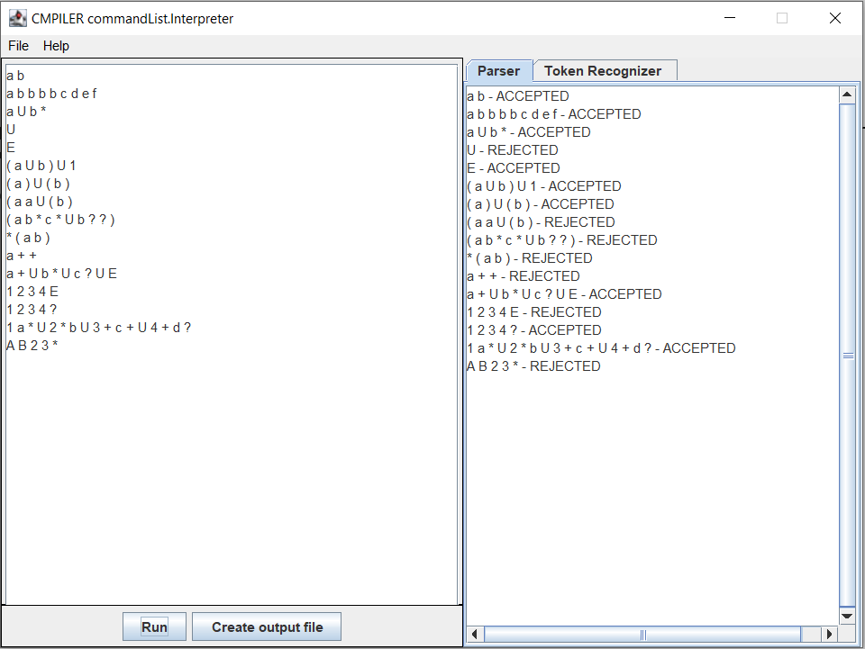
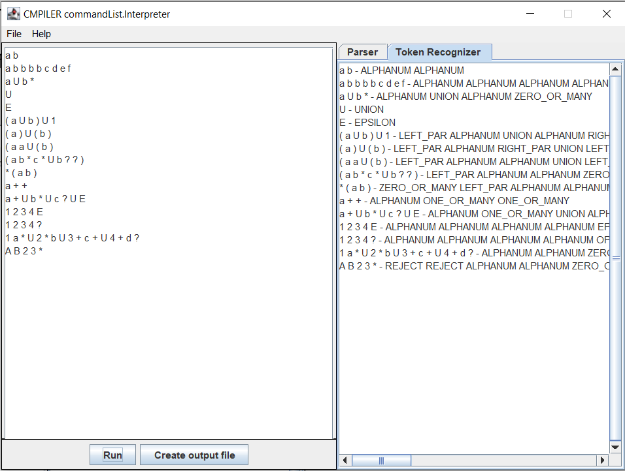
Running the GUI
3. Press Run to print the result in the right side of the Interface.
There are two tabs for the result the Parser and the Lexer.
The Parser shows if the whole string is “Rejected” or “Accepted” by the LL(1) parser Grammar each Strings are separated by next line ('\n').
The Lexer shows the token type of each scanned characters.

Slide 24
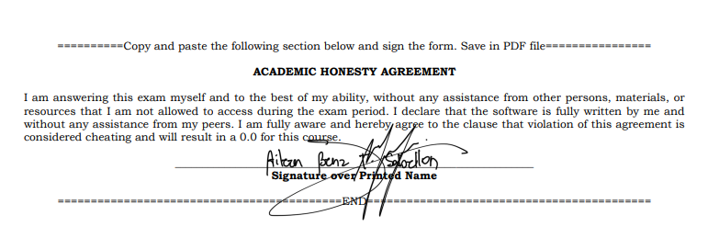
FINALS: Honesty Form

